Slide 1
Application Study 2820 6X4 Tipper with NRS – BS6 Panchgaon, Nagpur
Members present:
Karthick Raghu, Service HO
Jegatheesvaran S, Field Service
Rajesh Kumar R, FQ
Pavan Kumar, PD
22nd Mar 2022

Slide 2
Field Application study - 6X4 2820 Tipper with NRS – BS6
Summary
Background of the study: 16TG axle casing failures are more in BGS 6X4 & 8X4 Tippers under L3R2 to L4R3 applications. But no major casing failures are reported in NRS Tipper models with 10TG casing under similar LR applications. Hence application study carried out in field by PD/CQ/Service
Application:
AL NRS vehicle(BS4 & BS6) population is high (~90%) compared to competition vehicles
Load carried: M sand/ Blue metal - One side load & return empty
Operating route: Unloading point is not fixed, it varies based on the customer's requirement
Road condition: Operating road condition was R2 – Kutcha road only at loading & unloading points. Remaining paved road
Suspension leaf addition (3-5 leaf plates) found in all vehicles
Load body extension by 1 feet found in most of the vehicles
GVW found between 41-45T in most of the cases. One found with 47T also. Actual LR found L3R2/ L4R2 against spec L2R2
RAW/ axle measured as 18.3T with 44.3T GVW. With 47T GVW, RAW/ axle can go upto ~19.5T
Field feedback:
Customer Voice in the site visited :- No complaints related to Axle
Suspension leaf plates addition being done to avoid spring failures
Competition Benchmark in the site:
TATA Casing box section found as 156 X 145 mm against AL casing 150 X 130 mm
Spot face found in RA2 carrier at bolt/ nut seat face & Studs are with double nuts in RA1 & RA2 in TATA
M12 equivalent 13 studs (double nuts) & 5 bolts available in TATA against 4 studs & 10 bolts (RA1) and 2 stud & 12 bolts (RA2) in AL
Vehicles sold in Nagpur AO (6X4 2820 NRS Tipper) till Jan’22 : 143 nos.
No. of rear axle related claims in the 143 vehicles till Mid Mar’22 : 15 nos.
(as per SAP data)
Drive head mtg joint leak (Labour claim) : 3
Casing bend (Labour claim) : 2
Casing crack at Spring seat area (Labour claim) : 1
Input shaft seal/ Thru shaft seal leak (Material claim) : 3
IAD failure/ noise (Material claim) : 2
Thru shaft bearing failure (Labour claim) : 1
Diff lock not working (Labour claim) : 1
IAD thrust washer broken (Material claim) : 1
Input shaft failure (Material claim) : 1

Slide 3
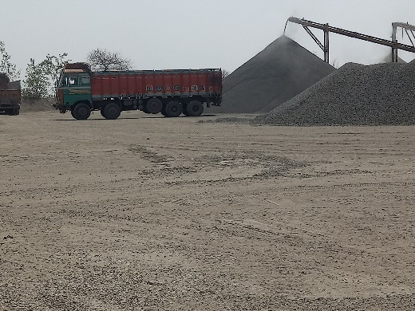
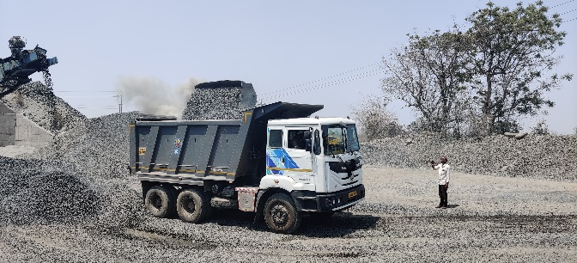
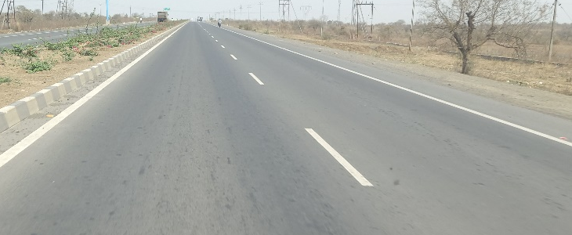
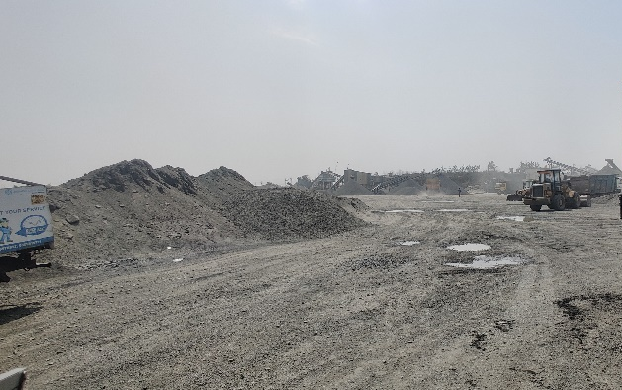
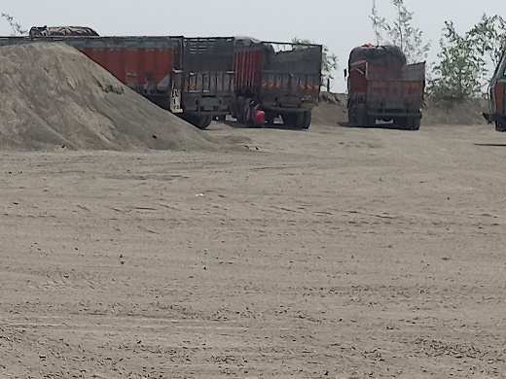
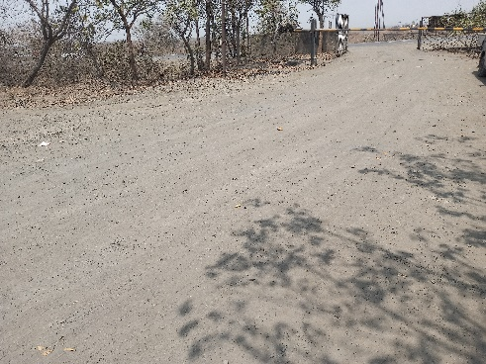
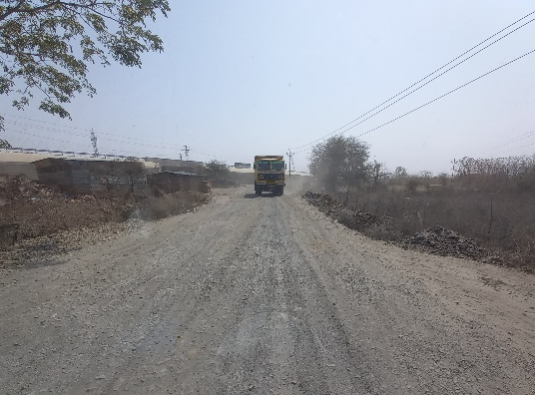
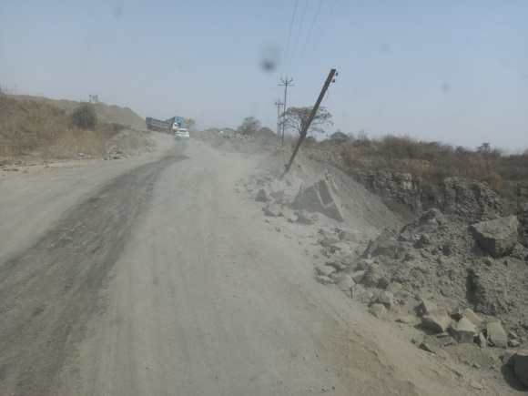
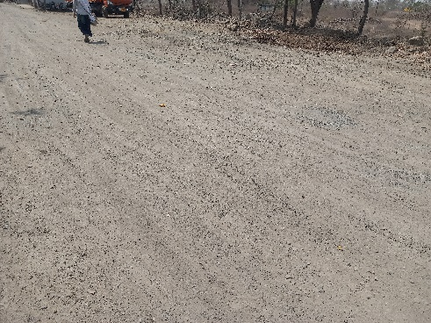
Field Application study - 6X4 2820 Tipper with NRS – BS6
Summary
Site 1 visited (Panchgaon)
Site 2 visited (Panchgaon)
Remaining road condition
Loading point (Crusher)
Loading point (Crusher)
Road condition at crusher: ~0.25 km (Kutcha road)
Road condition at crusher: 1 km (Kutcha road)
Unloading point not fixed – Varies based on Customer requirement

Slide 4
Field Application study - 6X4 2820 Tipper with NRS – BS6
Summary
 | Vehicle 1 with M sand | Vehicle 1 with Blue metal | Vehicle 2 | Vehicle 3
Chassis | MB1H3DHD8MPKM4221 | MB1H3DHD8MPKM4221 | MB1H3DHD6LPYL8269 | MB1H3DHD2LPML9570
Veh Reg. number | MH31FC5310 | MH31FC5310 | MH40CD0844 | MH40CD0783
CBN number | CTG282016B0003 | CTG282016B0003 | CTG282016B0003 | CTG282016B0003
Veh model | M2820T H 6SET L2R2 R4 SNR LC 16FET | M2820T H 6SET L2R2 R4 SNR LC 16FET | M2820T H 6SET L2R2 R4 SNR LC 16FET | M2820T H 6SET L2R2 R4 SNR LC 16FET
DOS | 10-Mar-21 | 10-Mar-21 | 15-Jan-21 | 21-Jan-21
Date of inspection | 22-Mar-22 | 22-Mar-22 | 22-Mar-22 | 22-Mar-22
Hours covered | 1936 hours/ 57758 kms | 1938 hours/ 57825 kms | 94307 kms | 2635 hours
Load | M sand | Blue metal | Blue metal | Blue metal
GVW-Kgs | 47210 (Un-laden wt: 11680) | 41440 (Un-laden wt: 11770) | 44390 | Not measured (Calculated ~37.3T)
Load body | Extended | Extended | Extended | Not extended
Suspension | 4 leaf plates added in FA 5 leaf plates in RA1 & RA2 | 4 leaf plates added in FA 5 leaf plates added in RA1 & RA2 | 5 leaf plates added in RA1 & RA2 | 4 leaf plates added in RA1 & RA2
Spec LR | L2R2 | L2R2 | L2R2 | L2R2
Actual LR | L4R2 | L3R2 | L4R2 | L3R2
Rear axle observations | No Drive head joint leak, no bolt loose | No Drive head joint leak, no bolt loose | No Drive head joint leak, no bolt loose | No Drive head joint leak, no bolt loose
Previous history/ Remarks | No attention related to rear axle | No attention related to rear axle | No attention related to rear axle | No attention related to rear axle 1st gear not engaging reported at 998 hours and ½ synchro & lay shaft 4th gear breakage reported at 1814 hours
Load body size (m) – L X B X H | 4.7 X 2.328 X 1.810 (height extended by 1 feet) | 4.7 X 2.328 X 1.810 (height extended by 1 feet) | 4.7 X 2.328 X 1.810 (height extended by 1 feet) | OE load body 4.7 X 2.328 X 1.510
Load body capacity (Cu.m) | 19.3 (16 + 3.3) | 19.3 (16 + 3.3) | 19.3 (16 + 3.3) | 16

Slide 5
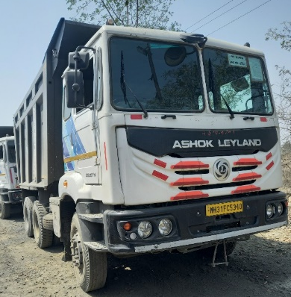
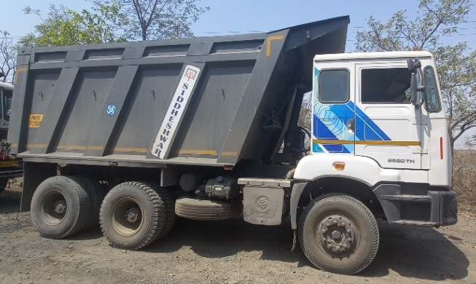
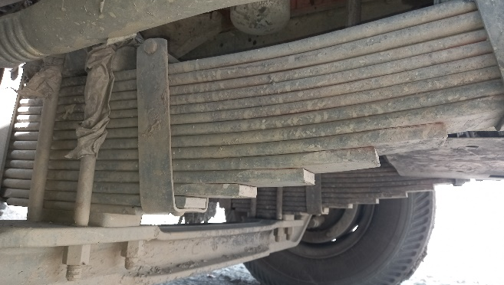
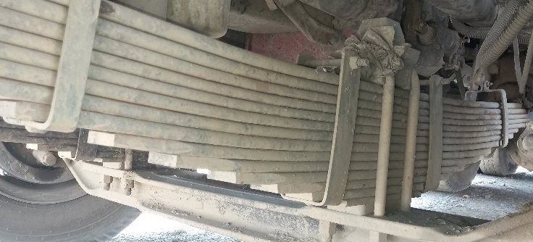
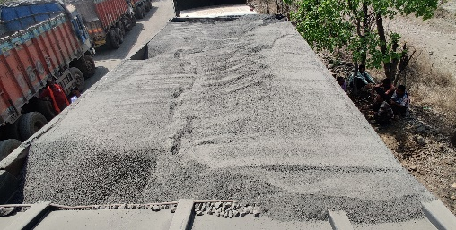
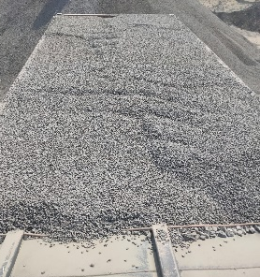
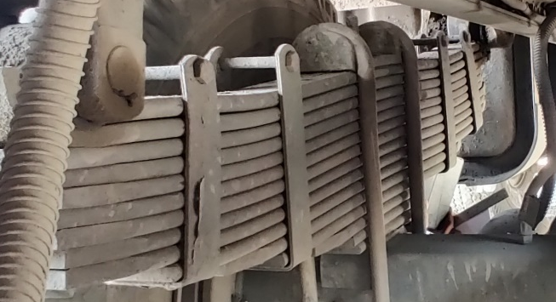
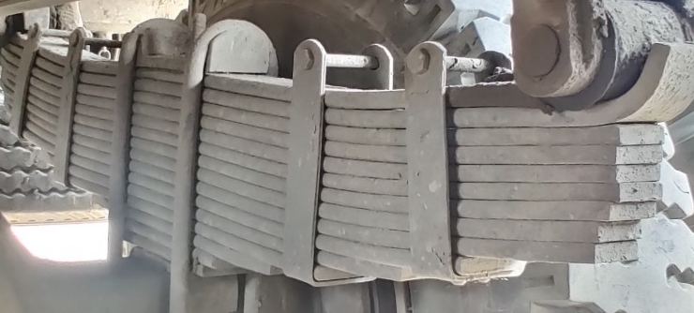
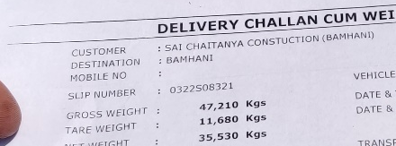
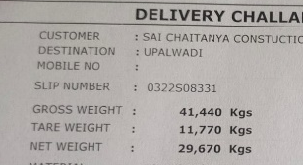
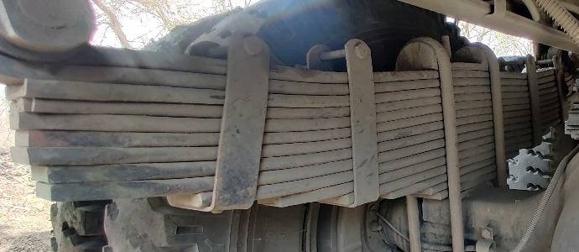
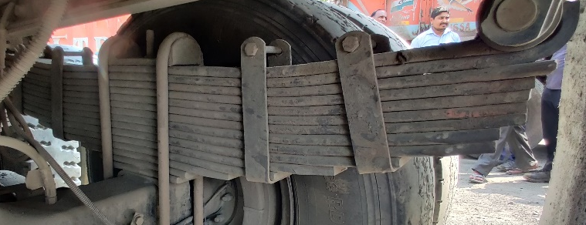
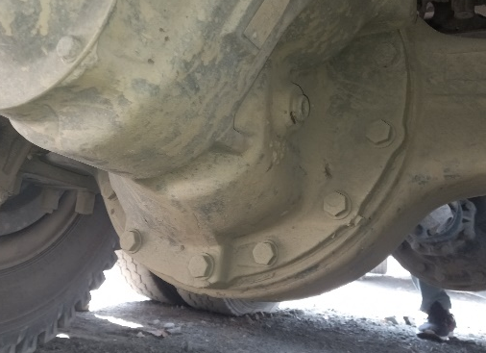
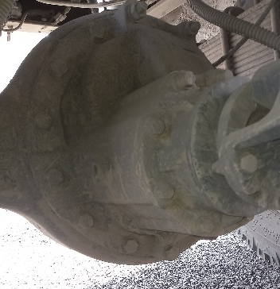
Vehicle 1
Load body extended
 | LH | RH
FA
RA1
RA2
Load : M sand
Load : Blue metal
No. of leafs:14
4 leafs added
No. of leafs:14
4 leafs added
No. of leafs:15
5 leafs added
No. of leafs:15
5 leafs added
Leaf deformation found
Leaf deformation found
No leak at drive head mtg joint and no bolt loosening observed
RA1
RA2
No. of leafs:15
5 leafs added
No. of leafs:15
5 leafs added
Leaf deformation found
Leaf deformation found
Center bolts, U bolts & nuts changed during Leaf plates addition

Slide 6
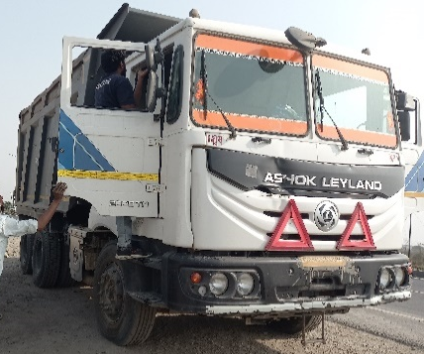
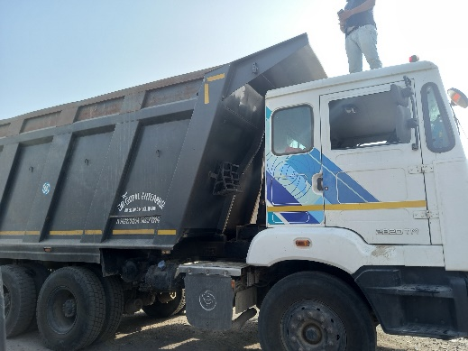
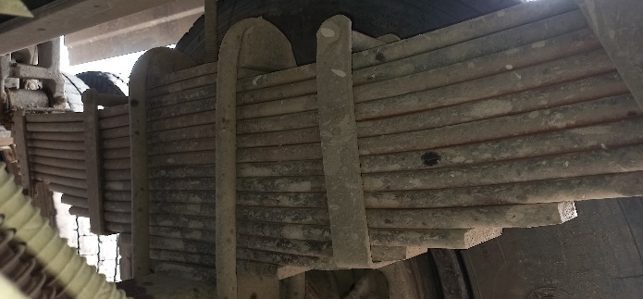
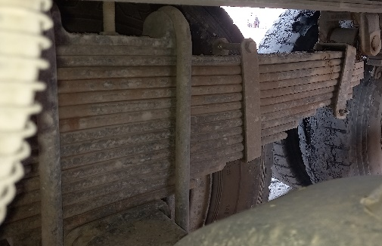
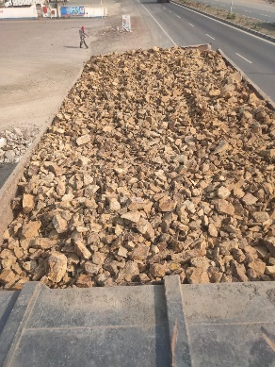
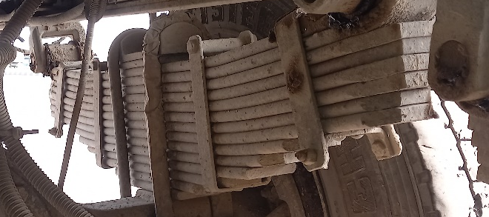
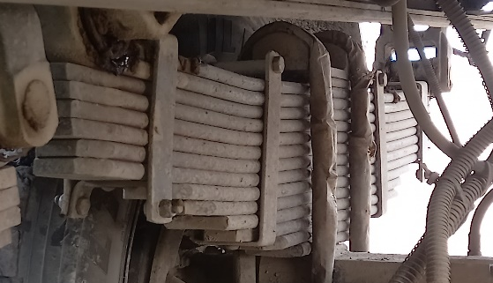
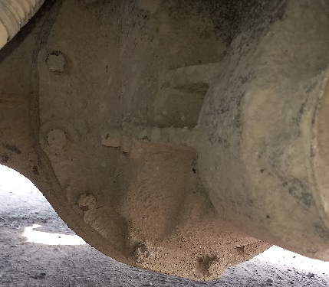
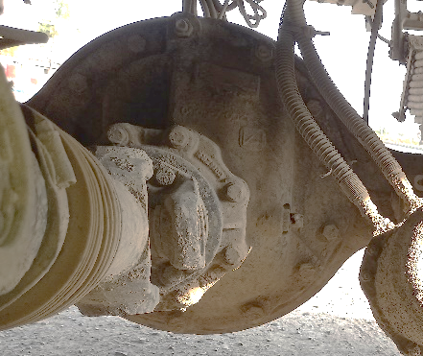
Vehicle 2
Load body extended
 | LH | RH
RA1
RA2
Load : Blue metal
No. of leafs:15
5 leafs added
No. of leafs:15
5 leafs added
No. of leafs:15
5 leafs added
No. of leafs:15
5 leafs added
No leak at drive head mtg joint and no bolt loosening observed
Leaf deformation found
Leaf deformation found
RA1
RA2
Center bolts, U bolts & nuts changed during Leaf plates addition

Slide 7
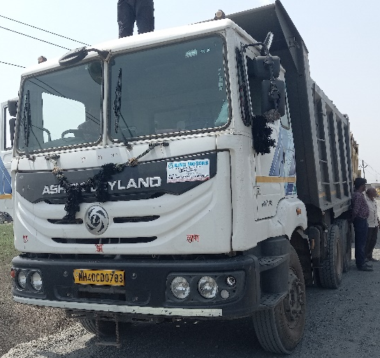
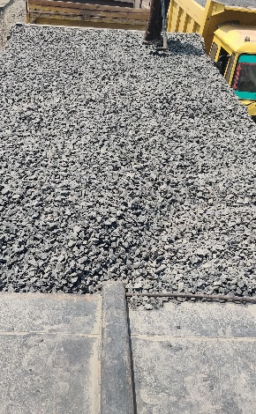
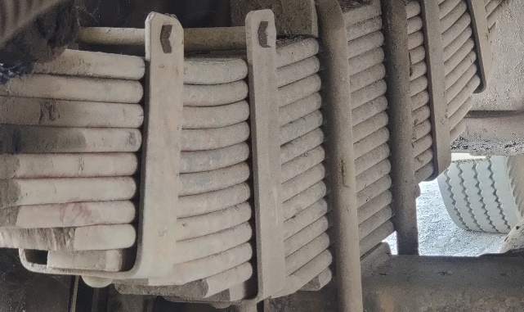
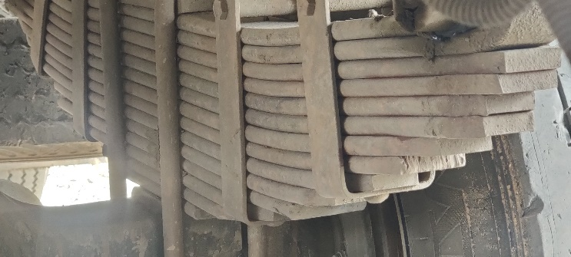
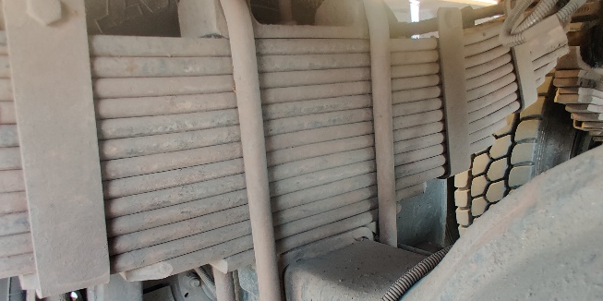
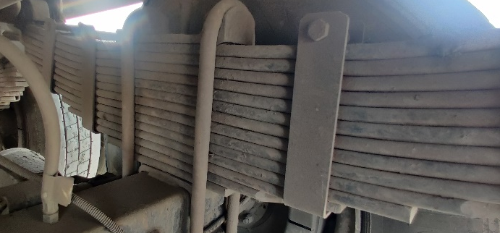
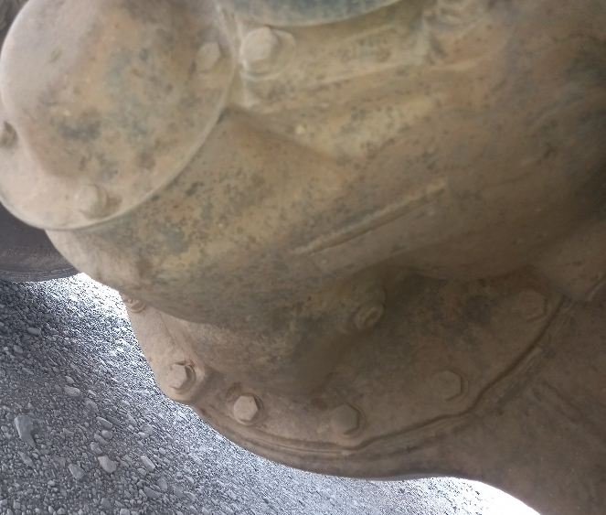
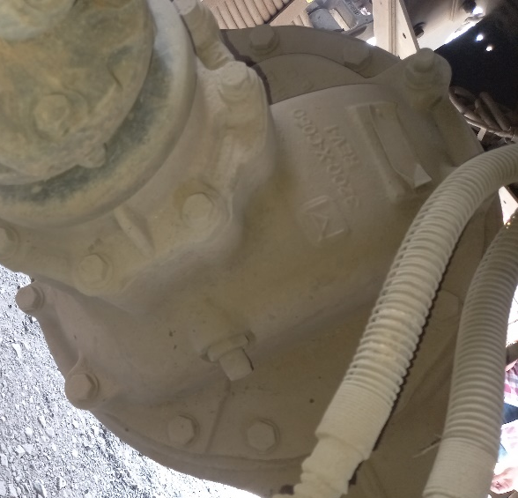
Vehicle 3
Load : Blue metal
Load body not extended
 | LH | RH
RA1
RA2
No. of leafs:14
4 leafs added
No. of leafs:14
4 leafs added
No leak at drive head mtg joint and no bolt loosening observed
Leaf deformation found
Leaf deformation found
RA1
RA2
No. of leafs:14
4 leafs added
No. of leafs:14
4 leafs added
Leaf deformation found
Leaf deformation found
Center bolts, U bolts & nuts changed during Leaf plates addition

Slide 8
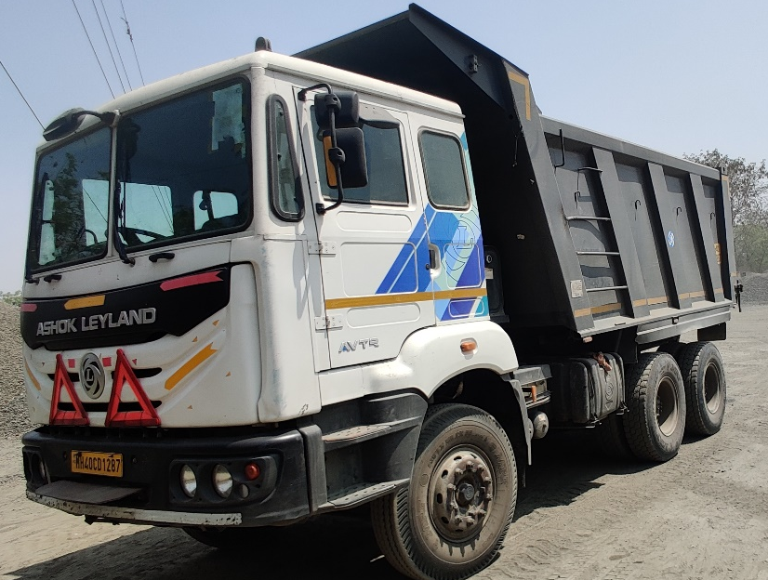
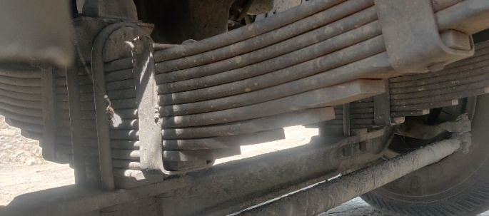
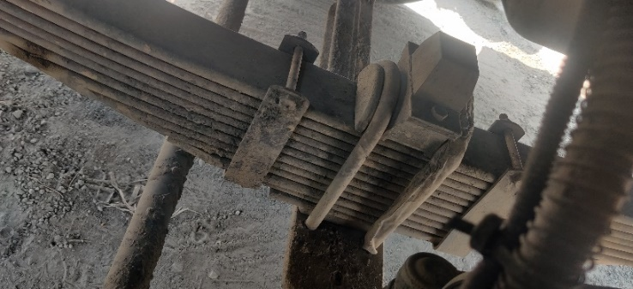
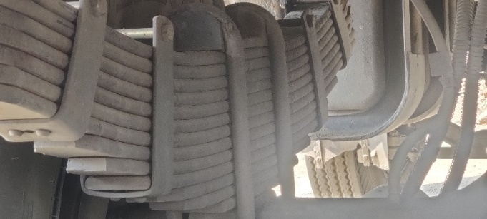
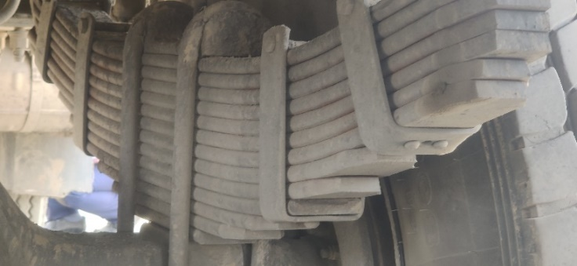
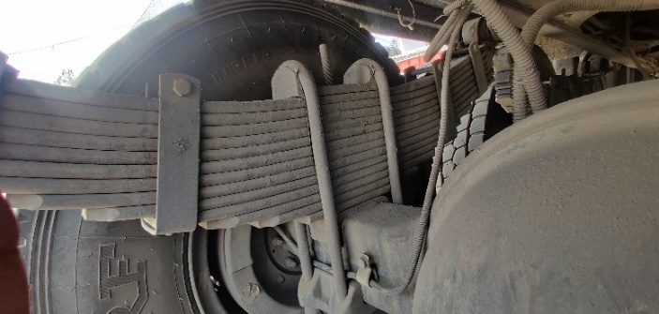
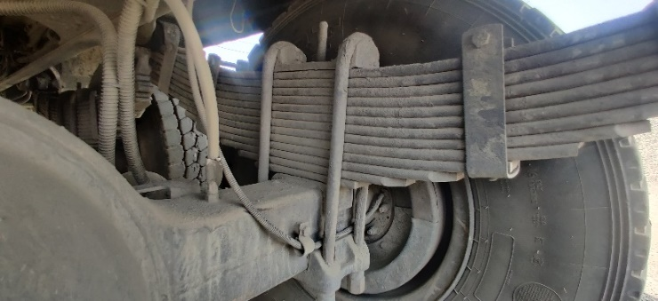
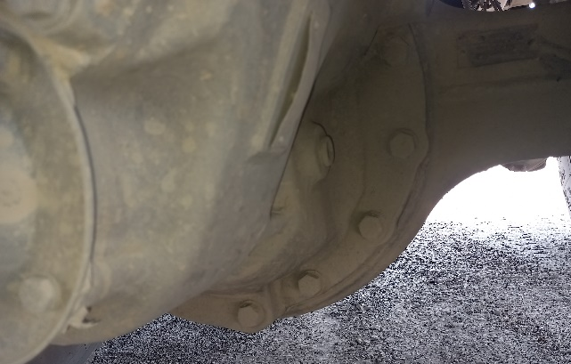
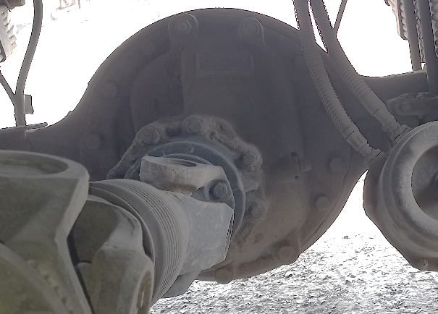
Unladen vehicle
Chassis MB1H3DHD4LPML9960
 | LH | RH
FA
RA1
RA2
No. of leafs:13
3 leafs added
No. of leafs:13
3 leafs added
Load body not extended
No. of leafs:13
3 leafs added
No. of leafs:13
3 leafs added
No leak at drive head mtg joint and no bolt loosening observed
RA1
RA2
No. of leafs:13
3 leafs added
No. of leafs:13
3 leafs added
Center bolts, U bolts & nuts changed during Leaf plates addition

Slide 9
Load measurement
Vehicle 1
Vehicle 2
Load : M sand
Load : Blue metal
Load : Blue metal
V
GVW (Kg) | 47210
FA | Axle wise load not measured
RAW - RA1
RAW - RA2
RAW (RA1+RA2)
GVW (Kg) | 41440
FA | 8400
RAW - RA1 | 16140
RAW - RA2 | 16900
RAW (RA1+RA2) | 33040
GVW (Kg) | 44390
FA | 8240
RAW - RA1 | 18355
RAW – RA2 | 17795
RAW (RA1+RA2) | 36150
RAW/ axle found upto 18.3T with 44.3T GVW. With 47T GVW, RAW/ axle can go upto ~19.5T

Slide 10
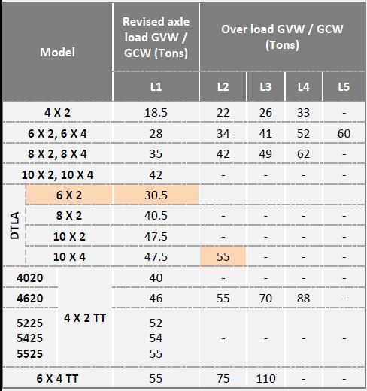


Operating LR against Spec LR
 | Spec | Actual
Load | GVW: 34T | GVW: 41.4T – 44.4T. One found with 47.2T
Road | 20% off road permissible | Kutcha road found only at Crusher
LR | L2R2 | L3R2/ L4R2

Slide 11







Competition Benchmark
TATA 2823 6X4 NRS Tipper
Veh Reg. number | MH49AT7372
Hours covered | 98713 kms
Load | Blue metal
GVW (Kgs) | 38840
Load body | Not extended
RAR | 5.57
Load body size (m) - L X B X H | 4.4 X 2.4 X 1.5
Load body capacity (Cu.m) | 16
 | LH | RH
RA1
RA2
No. of leafs:13
No. of leafs:13
GVW | 38840
FA | 6055
RAW - RA1 | 16665
RAW - RA2 | 16120
RAW (RA1+RA2) | 32785
No. of leafs:13
No. of leafs:13
RA1 axle number
RA2 axle number

Slide 12

Competition Benchmark
TATA 2823 6X4 NRS Tipper
 | AL 2820 6X4 NRS Tipper – 10TG | TATA 2823 6X4 NRS Tipper
Photo
Load body capacity | 16 Cu.m (OE load body) | 16 Cu.m
Casing box section | 150 X 130 mm (16TG: 154 X 139.7 mm & 18TG: 158 X 145 mm) | 156 X 145 mm
Casing thickness | 13 mm (16TG: 14mm & 18TG: 16 mm) | No info
TATA axle casing box section found near equivalent to 18TG (based on box width & height)

Slide 13
Competition Benchmark
TATA 2823 6X4 NRS Tipper
 | AL 2820 6X4 NRS Tipper | TATA 2823 6X4 NRS Tipper
RA1 Drive head mounting | Bolt/ stud size: M16 X 2 (Stud nut side M16X1.5) No. of stud & bolts: 4 & 10 | Stud size: Equivalent to M12 No. of study & bolts: 13 & 5 Studs are with double nuts.
Top
Top
RH
RH
LH
LH
Bottom
Bottom
Stud with single nut
Bolt
Stud with double nut
Studs are with double nuts in TATA

Slide 14


Competition Benchmark
TATA 2823 6X4 NRS Tipper
 | AL 2820 6X4 NRS Tipper | TATA 2823 6X4 NRS Tipper
RA2 Drive head mounting | Bolt/ stud size: M16 X 2 (Stud nut side M16X1.5) No. of stud & bolts: 2 & 12 | Stud size: Equivalent to M12 No. of study & bolts: 13 & 5 Studs are with double nuts. Spot face found on bolt/nut seat face
Top
Top
RH
LH
RH
LH
Bottom
Bottom
Stud with single nut
Bolt
Stud with double nut
Studs are with double nuts in TATA & spot facing found in bolt/ nut seat face

Slide 15
Camber measurement
Veh Reg number | Load |  | FA1 |  | RA1 |  | RA2 |  | Remarks
 |  |  | LH | RH | LH | RH | LH | RH
MH31FC5310 |  | No. of leafs | 14 | 14 | 15 | 15 | 15 | 15
 | Unladen | Camber (mm) | 125 | 105 | 75 | 75 | 75/80 | 75/80 | Unladen wt 11680 Kgs.
 | Laden - M sand | Load distribution | Not checked |  |  |  |  |  | GVW 47210
 |  | Camber (mm) | 55/60 | 90/95 | 38 | 60 | 35 | 60
 | Laden - Blue metal | Load distribution | 8400 |  | 16140 |  | 16900 |  | GVW 41440
 |  | Camber (mm) | 100/105 | 95/100 | 50/55 | 55 | 50/55 | 63/65
MH40CD0783 | Laden - Blue metal | No. of leafs | No info | No info | 14 | 14 | 14 | 14 | GVW 37300 *
 |  | Camber (mm) | 110 | 120 | 80 | 80 | 100 | 80
MH40CD1287 | Unladen | No. of leafs | 12 | 12 | 13 | 13 | 13 | 13
 |  | Camber (mm) | 135 | 140 | 115 | 125 | 125 | 120
MH49AT7372 (TATA) | Laden - Blue metal | No. of leafs | No info | No info | 13 | 13 | 13 | 13
 |  | Load distribution | 6055 |  | 16665 |  | 16120 |  | GVW38840
 |  | Camber (mm) | 10/20 | 55/60 | 5 | 20 | 20 | 20/22
* Pay load calculated considering blue metal density 1600 kg/ m³ . GVW not taken in weigh bridge
Positive camber & leaf addition observed in all vehicles inspected

Slide 16




Drive head mtg bolts torque inspection
Chassis | MB1H3DHD6MPHN1170
Veh Reg. number | MH31FC5689
CBN number | CTG282016B0003
Veh model | M2820T H 6SET L2R2 R4 SNR LC 16FET
DOS | 29-Oct-21
Date of inspection | 22-Mar-22
Hours covered | 650 hours/ 20949 kms
Load body | Not Extended
Rear axle observations | No Drive head joint leak & no bolt loosening
Previous history/ Remarks | No attention related to rear axle
Top
Spec: 196-262 Lbft
Not checked
Not checked
Not checked
RA2
Not checked
Not checked
Not checked
Not checked
RH
LH
Not checked
Not rotated with 200 Lbft
No leak at drive head mtg joint and no bolt loosening observed
RA1
RA2
Not checked
Not rotated with 200 Lbft
Not checked
Not rotated with 200 Lbft
Not rotated with 200 Lbft
Bottom
Torque found ok in 4 bolts inspected. Others not checked

Slide 17
Warranty claims in 143 nos. of 6X4 2820 NRS Tippers sold at Nagpur Area Office
Vehicles sold in Nagpur AO (6X4 2820 NRS Tipper) till Jan’22 : 143 nos.
No. of rear axle related claims in the 143 vehicles till Mid Mar’22 (as per SAP data) : 15 nos.
Drive head mtg joint leak : 3
Casing bend : 2
Casing crack at Spring seat area : 1
Input shaft seal/ Thru shaft seal leak : 3
IAD failure/ noise : 2
Thru shaft bearing failure : 1
Diff lock not working : 1
IAD thrust washer broken : 1
Input shaft failure : 1
Claim No | Chassis number | KM Reading | km/hrs | Sold date | Date Of Failure | Material Description | Dealer | Defect | Material/ Labour
26816419 | MB1H3DHD9LRMJ2628 | 1584 | H | 30-Jan-21 | 11-Mar-22 | M2820T H 6SET L2R2 N3 SNR LC 16FET | AMPL-Nagpur | Drive head mtg joint leak | Labour
26297272 | MB1H3DHD9LRMJ2628 | 981 | H | 30-Jan-21 | 3-Oct-21 | M2820T H 6SET L2R2 N3 SNR LC 16FET | AMPL-Nagpur | Drive head mtg joint leak | Labour
25797608 | MB1H3DHD0LRCE8071 | 1707 | H | 17-Oct-20 | 2-Apr-21 | M2820T H 6SET L2R2 R4 SNR LC 16FET | AMPL-Nagpur | Drive head mtg joint leak | Labour
26187815 | MB1H3DHD2LRAG0071 | 1575 | H | 31-Dec-20 | 17-Aug-21 | M2820T H 6SET L2R2 N3 SNR LC 14FET | Arya Autowheels-Nagpur | Casing bend | Labour
26496219 | MB1H3DHD0LRAG3115 | 1834 | H | 12-Nov-20 | 8-Dec-21 | M2820T H 6SET L2R2 R4 SNR LC 16FET | Arya Autowheels-Nagpur | Casing bend | Labour
26353082 | MB1H3DHD2LRAG0071 | 1851 | H | 31-Dec-20 | 9-Oct-21 | M2820T H 6SET L2R2 N3 SNR LC 14FET | Arya Autowheels-Nagpur | Casing crack at Spring seat area | Labour
26682968 | MB1H3DHD0LPYL7943 | 1887 | H | 31-Dec-20 | 2-Feb-22 | M2820T H 6SET L2R2 R4 SNR LC 16FET | Universal-Kamptee Road | Thru shaft bearing failure | Labour
26684332 | MB1H3DHD2LPML9567 | 1189 | H | 6-Feb-21 | 1-Feb-22 | M2820T H 6SET L2R2 R4 SNR LC 16FET | AMPL-Nagpur | Input shaft seal leak | Material
26521312 | MB1H3DHDXMPKM4222 | 731 | H | 30-Mar-21 | 16-Dec-21 | M2820T H 6SET L2R2 R4 SNR LC 16FET | AMPL-Nagpur | Input shaft seal leak | Material
26381896 | MB1H3DHD4LPYL7945 | 1579 | H | 29-Dec-20 | 29-Oct-21 | M2820T H 6SET L2R2 R4 SNR LC 16FET | AMPL-Nagpur | Diff lock not working | Labour
26353462 | MB1H3DHD6LPAL7263 | 1520 | H | 17-Feb-21 | 10-Oct-21 | M2820T H 6SET L2R2 N3 SNR LC 14FET | RM-Sangli | Input shaft failure | Material
26353086 | MB1H3DHD2LRAG0071 | 1851 | H | 31-Dec-20 | 9-Oct-21 | M2820T H 6SET L2R2 N3 SNR LC 14FET | Arya Autowheels-Nagpur | Thru shaft seal leak | Material
26291772 | MB1H3DHDXLPML9963 | 1180 | H | 31-Jan-21 | 29-Sep-21 | M2820T H 6SET L2R2 R4 SNR LC 16FET | AMPL-Nagpur | IAD noise | Material
25970649 | MB1H3DHD4LPYL7945 | 1435 | H | 29-Dec-20 | 11-Jun-21 | M2820T H 6SET L2R2 R4 SNR LC 16FET | AMPL-Bhandara | IAD thrust washer broken | Material
25827493 | MB1H3DHD4LPYL7945 | 1148 | H | 29-Dec-20 | 14-Apr-21 | M2820T H 6SET L2R2 R4 SNR LC 16FET | AMPL-Nagpur | IAD failure | Material

Slide 18
Thanks

